Slide 1
BULK WAREHOUSE RECEIPTS
Steps guide

Slide 2

Agenda
To provide step-wise GRN execution process in KNK system.

Slide 3
Timeline Overview
Below is the activity-wise timeline for the execution of Goods Receipt in KNK system.
Export Serials from KNI
Validate Receipt Physically
Create Purchase Order
5 mins
30 mins
5 mins
5 mins
15 mins
Approve Purchase Order
Import Serials to KNK
Based the above activities the GRN processing can be completed in 1 hour, which currently takes 1 - 3 days.

Slide 4
Activities
Create Purchase Order
Approve Purchase Order
Export Serials from KNI
Import Serials to KNK
Validate Serials

Slide 5
Create Purchase Order
Actors
System [Through Integration with KNI System]
Purpose
To create the “Purchase Order” in KNK system based on the Products delivered from KNI system
Description
The Purchase Order is created in the KNK system as soon as the delivery order is delivered [processed in the system] from the KNI system.
As soon as the order in created in KNK, one Email notification is sent to the checked by user in the Purchase Order [currently “Allan Kingoo” will be changed to “Adarsh Shah” from March 16th] to approve the purchase order.

Slide 6
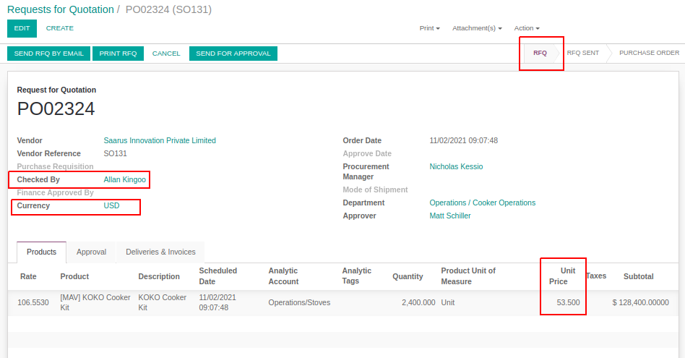
Create Purchase Order

Slide 7
Activities
Create Purchase Order
Approve Purchase Order
Export Serials from KNI
Import Serials to KNK
Validate Serials

Slide 8
PO approvals
Actors
Adarsh Shah, Smit Shir, Matt, Nick
Purpose
Users who have business accountability, approves the created purchase order on behalf of KNK
Description
The Approval process starts as soon as we have the Purchase Order created in the KNK system. On creation, the system sends an automated notification to the “Level 1” approver to kick start the approval.
In the KNK system we have a matrix of the Approvers, responsible to approve the PO in the KNK system. Currently, we have 4 level approval for Cooker and Canister purchases.
Level 1: Checked by: Currently Adarsh Shah is responsible for level one approval.
Level 2: Procurement Manager: This approval is done by Smit Shir.
Level 3: HOD Approval: As the purchases for Cooker and Canister comes under the “Supply Chain” department and HOD for this department is Matt, so Matt approves at level three.
Level 4: Finance Approval: This is done by Nicholas Stokes [as Purchase Order Sum is greater than 200,000 KSH]
Once the Final approval is done the incoming shipment (/GRN) is created (automatically) in the system and now the warehouse team and start further processing.

Slide 9
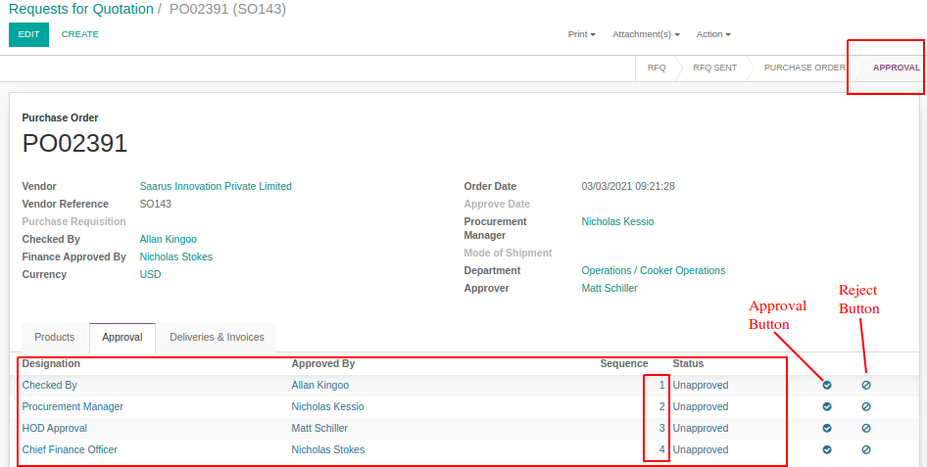
PO Approvals
Note: In case, if any approver rejects the Purchase Order or Update the information, the PO will go back to the RFQ state and the complete Approval process will be repeated again after making the corrections.

Slide 10
Activities
Create Purchase Order
Approve Purchase Order
Export Serials from KNI
Import Serials to KNK
Validate Serials

Slide 11
Export Serials from KNI System
Actors
Warehouse Supervisor [Allan Kingoo]
Purpose
User collects all the serial numbers information from the KNI system to Import in the KNK GRN
Description
In this process, the user needs to finalize the Sales Order and Delivery order in the KNI system which has reached the KNK warehouse.
Once the Delivery Order information is confirmed, the user can export the information through the predefined export template.
In the export template, all the product serials will be fetched and the list of product serials can be used in the KNK system.

Slide 12
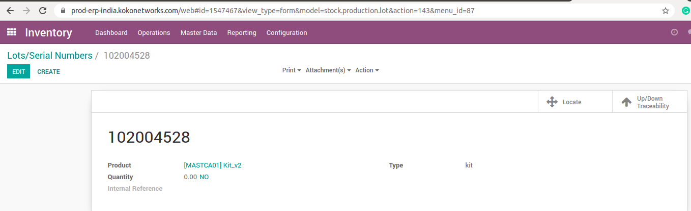
Search the Relevant Delivery Order for Export
Once the users have the Container in the Kenya they can open that and pick one serial number from the container.
Now user need to login to the Saarus ERP system and navigate to the Inventory > Master data > Lots and Serial Number.
Here, User can search for the Lot number, he scanned from the container. In the lot and serial Master, we have a option for updown traceability, where we can see the Delivery order reference number.

Slide 13
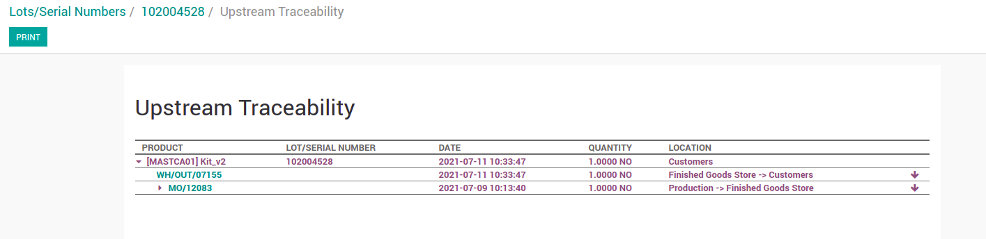
Search the Relevant Delivery Order for Export
As shown in the Image below, User have found the Delivery Order which we needs to Export the serials from.
Now the user can navigate to Inventory > Operations > Transfers and search for the Delivery order and Export the Serials [As shown in the next slide].

Slide 14
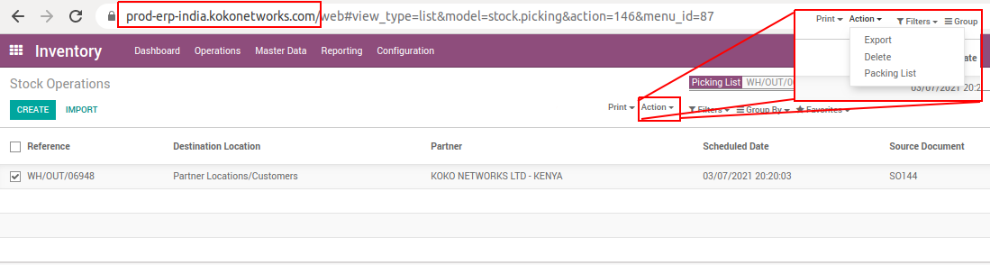
Export Serials from KNI System
Once the user clicks on the export button, the following window will appear and the user can select the predefined template “For Export” and download the required sheet.
The columns are already listed in the template so no efforts required at this step. [Columns shown in the screen is next slide]

Slide 15
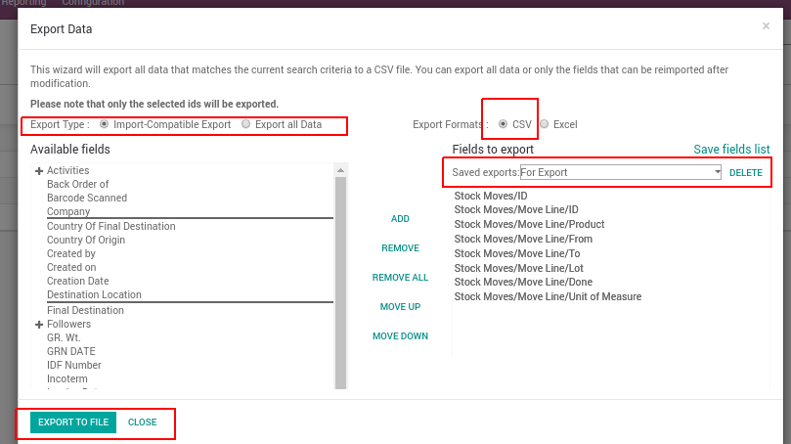
Export Serials from KNI System

Slide 16
Activities
Create Purchase Order
Approve Purchase Order
Export Serials from KNI
Import Serials to KNK
Validate Serials

Slide 17
Import Serials to KNK
Actors
Warehouse Supervisor [Allan Kingoo]
Purpose
User to import all the serial data, exported from the KNI system, to the KNK System
Description
Once the data from the KNI system is exported, the user can find the Purchase Order created in the KNK system, respective to the Sales order [In KNI].
Form the Purchase Order in the KNK system, the user can export the Incoming shipment details from the pre-defined template in the KNK system.
In the incoming shipment template, the user needs to copy-paste all the product serials exported from the KNI system.
Once this process is done User can import the same sheet in the KNK system.

Slide 18
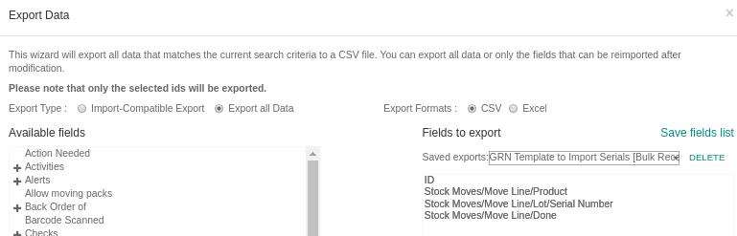
Import Serials to KNK
For import, we need to export the CSV file of the GRN [In KNK], from the pre-created template in the KNK System. the template will have the following columns as shown in the screen below:

Slide 19
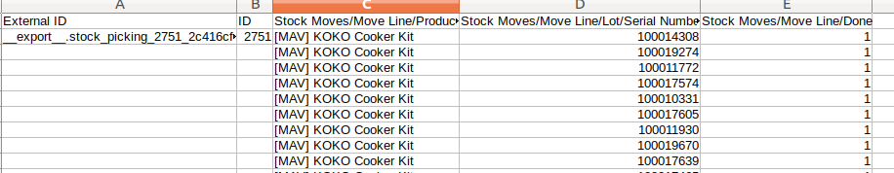
Import Serials to KNK
once we export the sheet, it will look like the sheet in the screen below:
once the user copies all the data in this sheet, it will be ready to be imported back to the system.

Slide 20
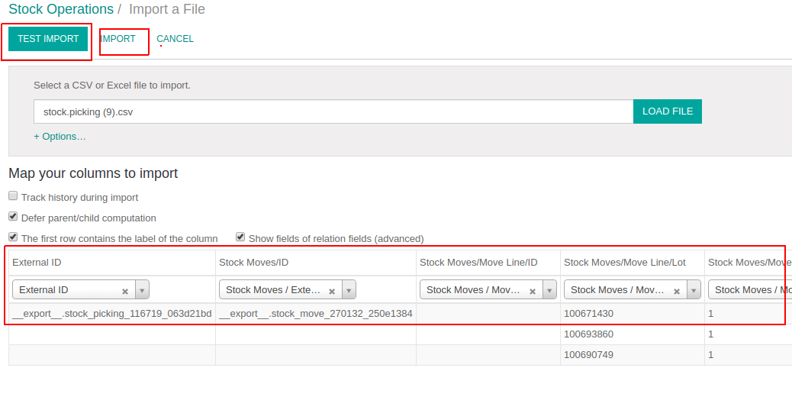
Import Serials to KNK
To import the sheet ,we need to click on the import button on the GRN / Incoming shipment list view, then load the file and click on the import button.

Slide 21
Activities
Create Purchase Order
Approve Purchase Order
Export Serials from KNI
Import Serials to KNK
Validate Serials

Slide 22
Validate Serials Physically (in Warehouse)
Actors
Warehouse Supervisor [Allan Kingoo]
Purpose
To make sure the Serials received physically and list of serials exported from KNI are the same without and discrepancy.
Description
Once the Shipment is received in the warehouse (KNK), the user need to scan all the items into an excel sheet to record the serials number received physically in the KOKO warehouse.
Once the list of physically received items is ready, the user can compare the sheet with the KNI export sheet.
Once this comparison is done, the user can validate the Incoming shipment in the KNK system and our products will be received in the KOKO warehouse.
Note: In case of any discrepancy in the serials, the warehouse supervisor can contact KNI team to get the clarity on the same.

Slide 23
Madhav Agarwal and Tim Muchai
m.agarwal@kokonetworks.com / t.muchai@kokonetworks.com

